Slide 1
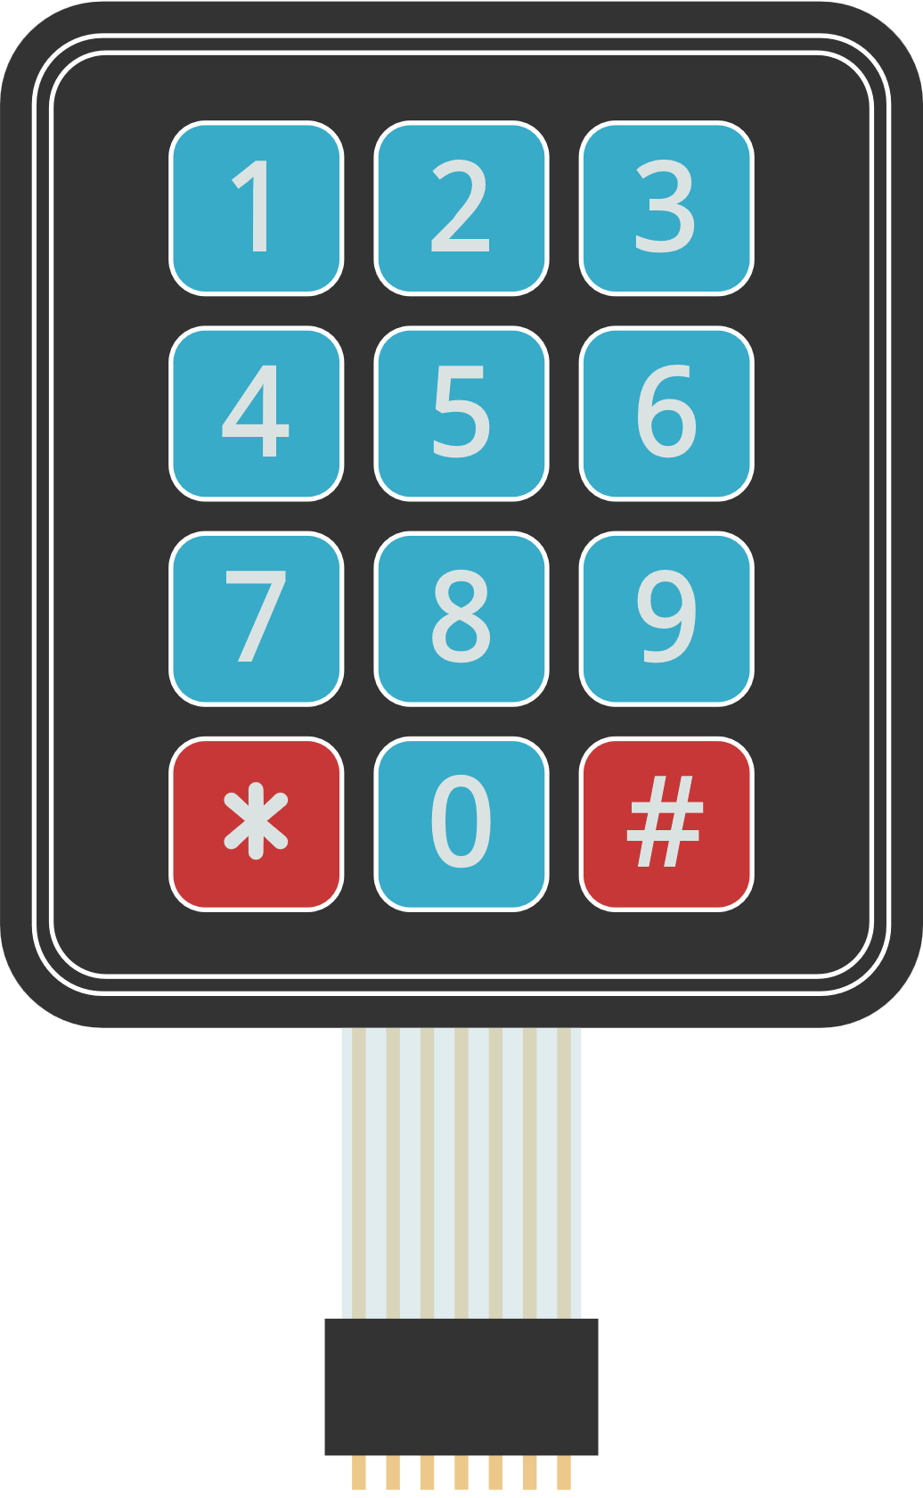
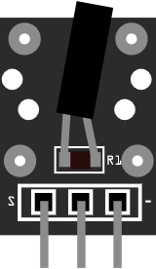
05 Tilt sensor
HDX
HDX
S1
QC
R1
R1
S
-
1 2 3
1 2 3 4 5 6 7

